Slide 1
Went well
XX add a ocean circ slide to sources/sinks of 14C?
Line up the age model examples a bit better
Bacon needs a bit more cleaning up

Slide 2
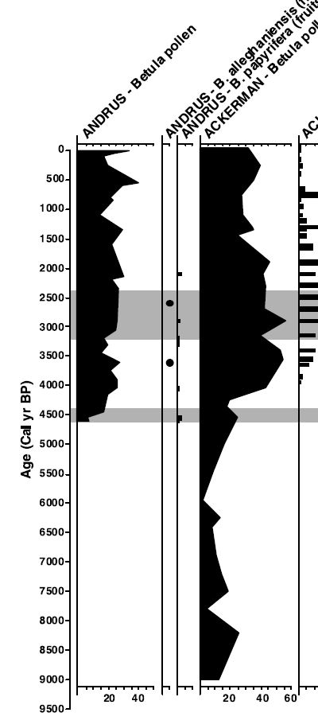
Dating and Age Model Uncertainty
For geologists, time is an unknown variable. It must be estimated. It has uncertainty.
Critical evaluation of age estimates and age models is fundamental to good inference in the paleogeosciences
Timing of Yellow Birch expansion
– Jackson & Booth 2002

Slide 3
Dating and age model uncertainty
Part I: Age Controls, Fundamentals of Radiocarbon Dating
Part II: Age-Depth Models & Chronologies, Classical Age Models
Part III: Bayesian Age-Depth Models & bacon

Slide 4
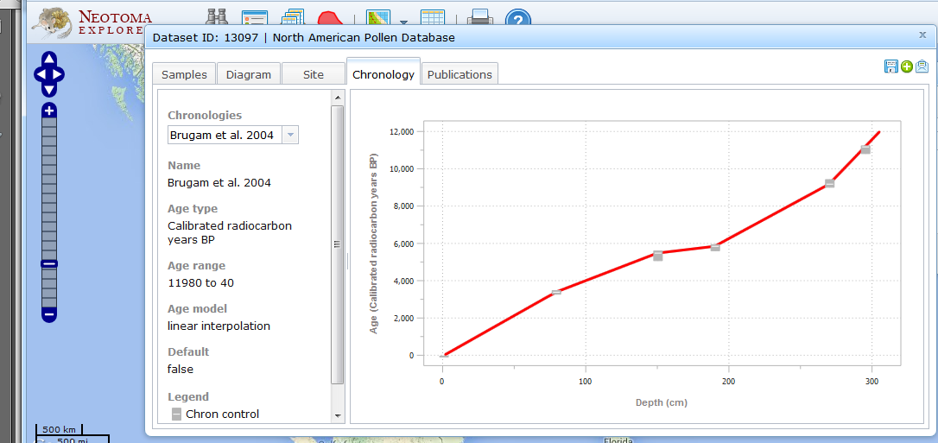
Terminology
Age Control: an estimate of absolute age, often with a specified uncertainty, for a sample within a core or stratigraphic profile that is used to constrain an age model.
Glimmerglass Lake
Source: Grimm et al. 2014 Age Models, Chronologies, and Databases Workshop: Complete Report and Recommendations. PAGES Workshop Report. Queens University, Belfast.

Slide 5
Terminology
Age-Depth Model: an algorithm used to estimate the age-depth relationship for a series of stratified paleoenvironmental data points. Age-depth models are used to make estimates of ages for depths not directly associated with an age control or to resolve discrepancies among age controls.
Glimmerglass Lake
Source: Grimm et al. 2014 Age Models, Chronologies, and Databases Workshop: Complete Report and Recommendations. PAGES Workshop Report. Queens University, Belfast.

Slide 6
Commonly Used Age Controls in Quaternary Paleoecology
Technique | Geological Context | Time Extent | Time Since What? | Comments
Radiocarbon | Organic carbon | <40,000 years BP | Death of organism | See rest of talk
Layer Counting | Ice, Lakes, Tree Rings | 10¹-10⁵ years | Deposition of layer | Nice when you can get it.
Lead-210 | Sediments | <150 years BP | Deposition of sediments | Good for last 1-2 centuries
Biostrati-graphic | Sediments | variable | Biological event | e.g. Ambrosia (ragweed) pollen rise with settlement
Tephras | Sediments, Ice | All history | Volcanic eruption | Time-instantaneous markers, dated using other techniques
Optically Stimulated Luminescence (OSL) | Quartz-rich sediments | 300 to 100,000 years BP | Exposure to sunlight | Favored by eolian geomorphologists
Cosmogenic Nuclides | Bedrock | Varies with nuclide. | Exposure to cosmic rays | ¹⁰Be, ²⁶Al, ³⁶Cl. Favored by glaciologists

Slide 7
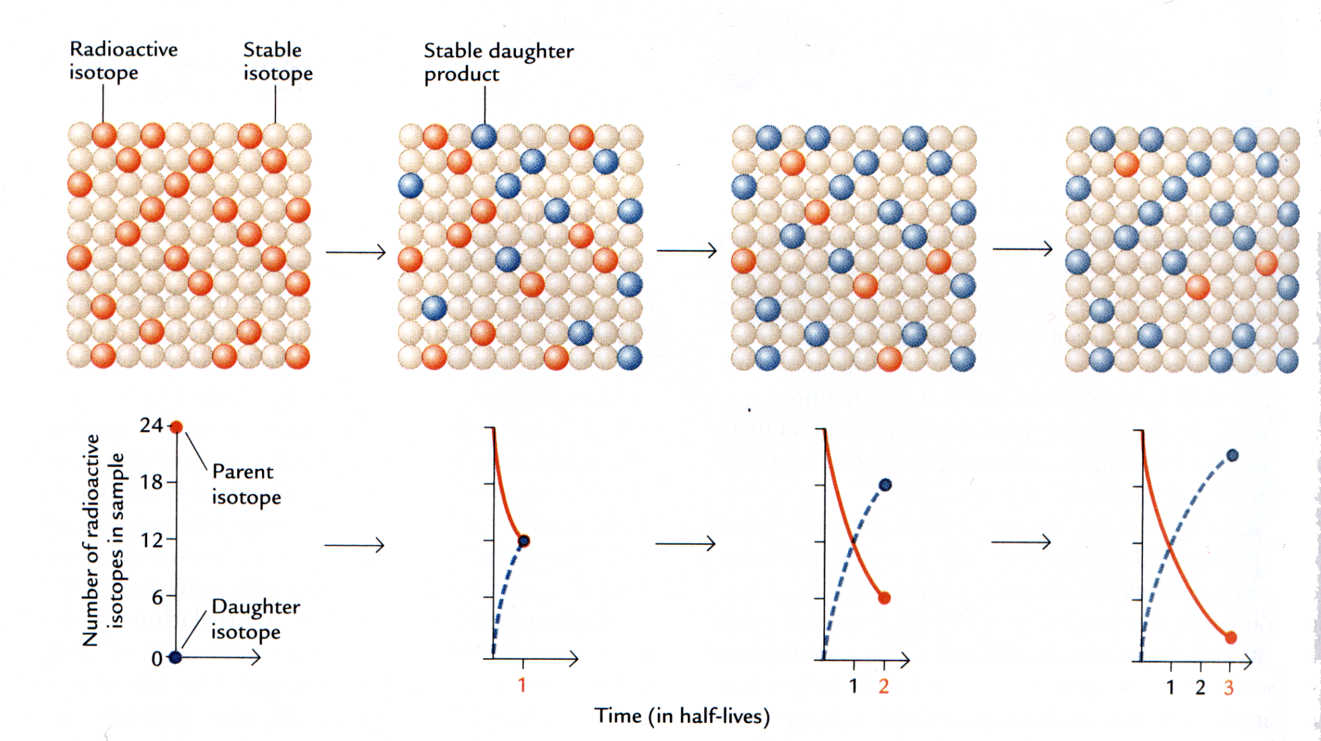
Principles of Radiometric Dating
Unstable isotopes decay exponentially
Each isotope has its own, fixed, rate constant (λ)
N_{t}=N₀e^{-λt}
t_{1/2} = (ln 2)/λ
N= Number of radioactive isotopes remaining at time T
N₀= Number of radioactive isotopes at start
λ= decay constant
t= time elapsed
t_{1/2}= half-life of substance
Ruddiman 2.9

Slide 8
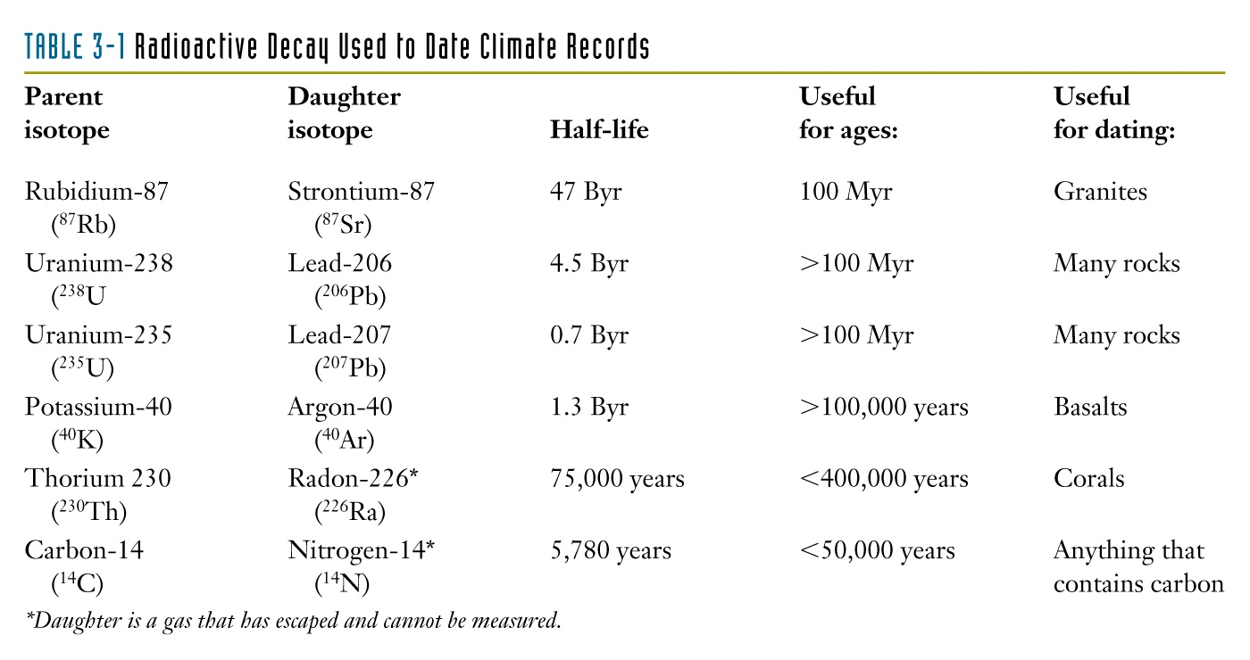
Principles of Radiometric Dating
Each radioactive isotopes has its own half-life, suitable for different timescales, found in different geological contexts.
5,730 years
Ruddiman Table 2.1

Slide 9
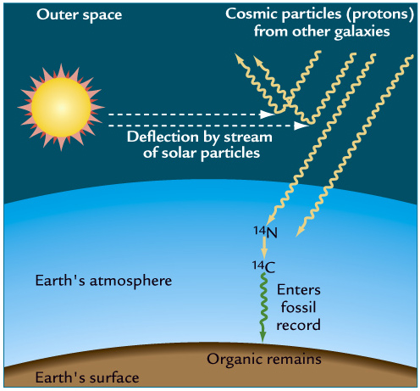
Principles of Radiocarbon dating
Carbon has three isotopes: two stable, one unstable:
¹²C : 98.89% of all C
¹³C : 1.11% of all C
¹⁴C : 0.0000000001% of all C
Radiocarbon produced by cosmic bombardment of atmospheric ¹⁴N
Carbon taken up by all living (organic) things via photosynthesis or their food
On death, organisms cease to take in ¹⁴C
In the dead material, as time goes by, ¹⁴C decays, produces ¹⁴N, which escapes to atmosphere
Ruddiman 14.15
Modified text from slide by Maarten Blaauw

Slide 10
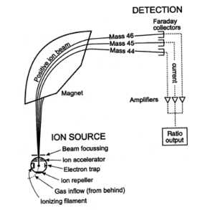
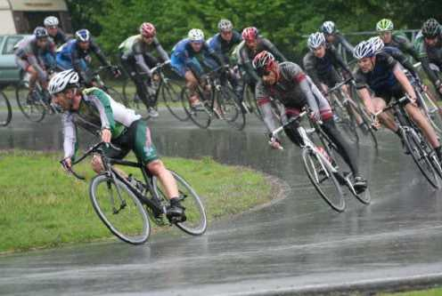
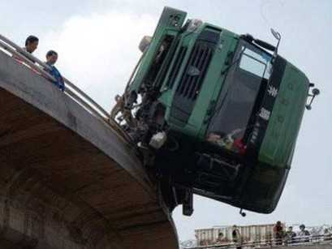
Measuring Radiocarbon: Accelerator Mass Spectrometry
¹²C
¹⁴C

Slide 11
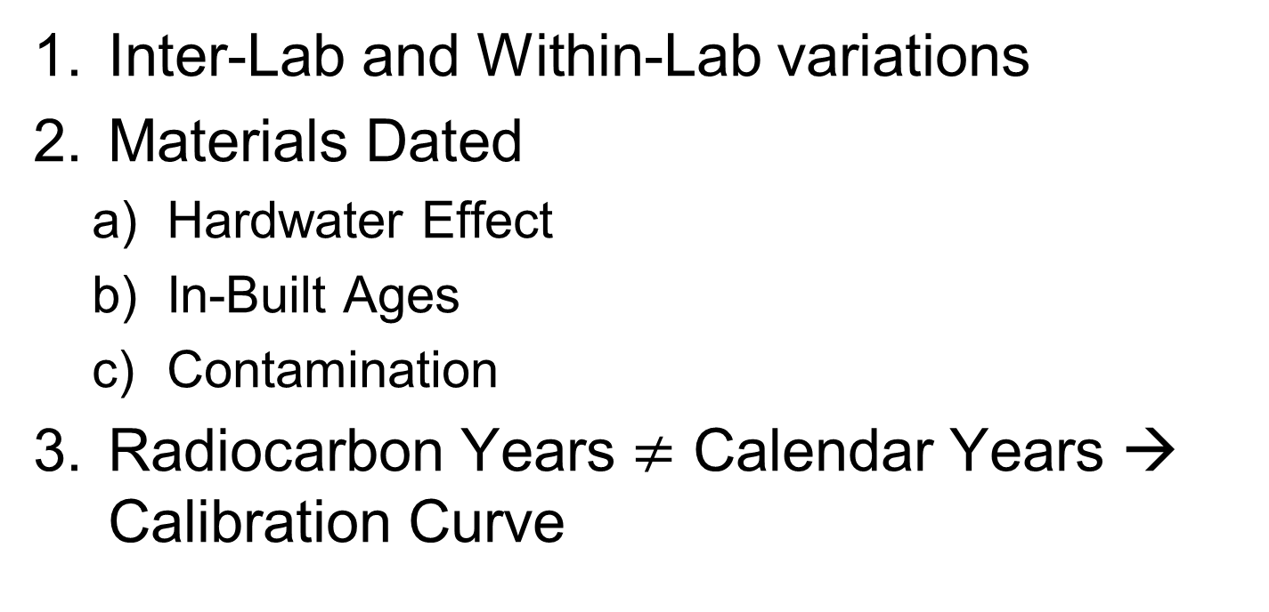
Common Complications in Radiocarbon Dating
Inter-Lab and Within-Lab variations
Materials Dated
Hardwater Effect
In-Built Ages
Contamination
Radiocarbon Years $≠$ Calendar Years → Calibration Curve

Slide 12
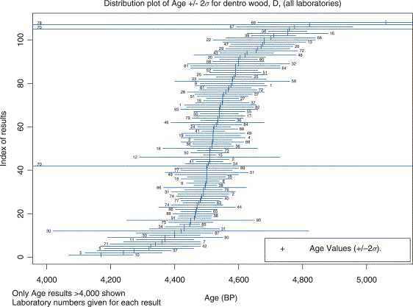
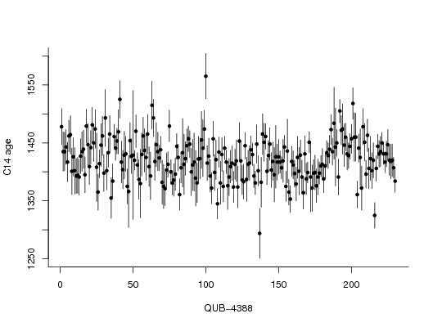
Inter-lab and Within-Lab Variations
True uncertainty
> reported analytical precision!
Inter-lab Variations
Within-lab Variations
Source: Belfast AMS Lab
Source: Maarten Blaauw

Slide 13
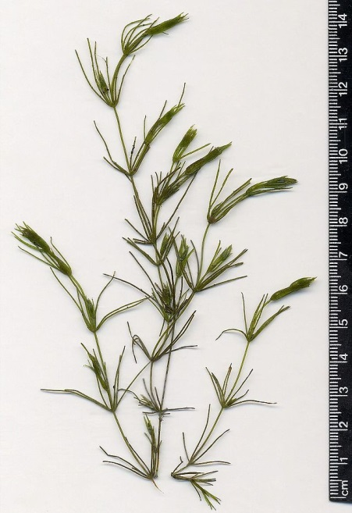
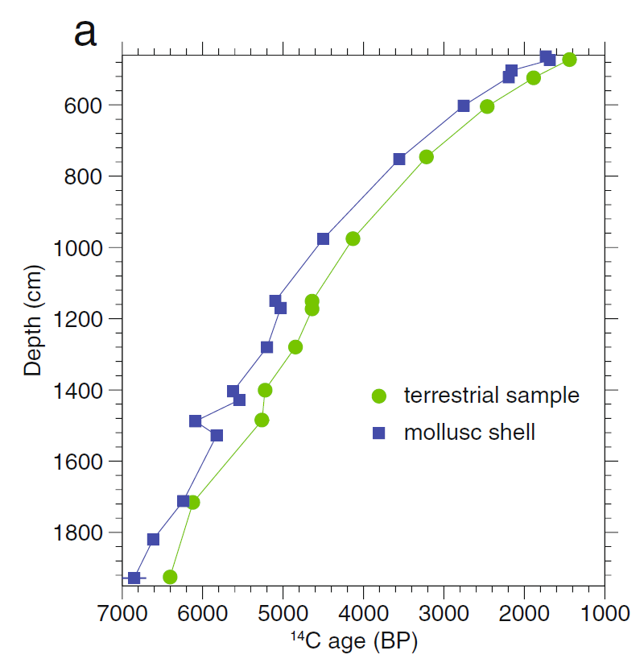
Hardwater Effect
Chara fragilis
Problem: The CO₂ in lakes & oceans comes from:
a) atmosphere
b) geological reservoirs – which contain ‘old’ carbon
Philippsen 2013 Heritage Science
Solution: Don’t date bulk sediments or aquatic materials or apply ‘reservoir’ correction
Problem: a) Many previously collected terrestrial records used bulk dates. b) Marine 14C has inherent reservoir/hardwater effect, on the order of centuries

Slide 14
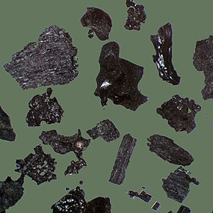
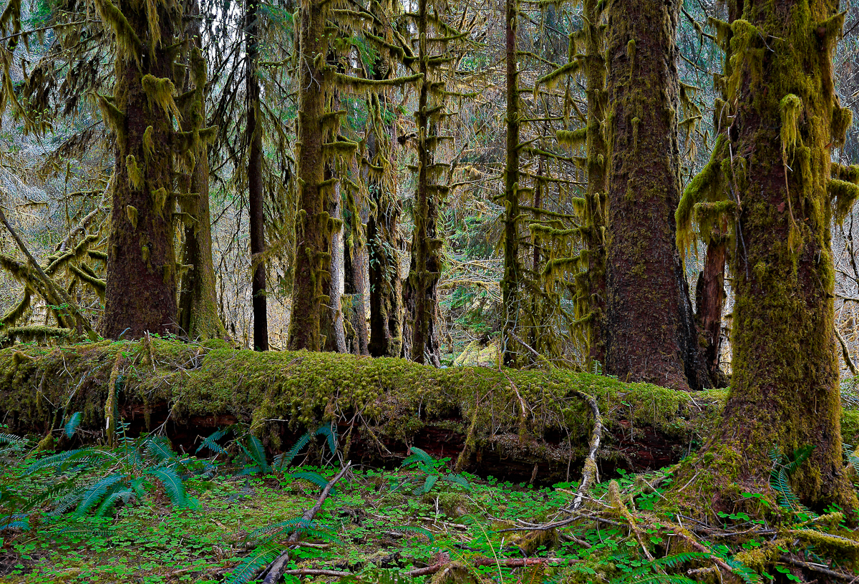
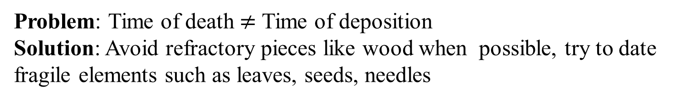
In-Built Ages
Charcoal collected and ¹⁴C-dated.
Does this indicate time of fire?
Problem: Time of death $≠$ Time of deposition
Solution: Avoid refractory pieces like wood when possible, try to date fragile elements such as leaves, seeds, needles

Slide 15
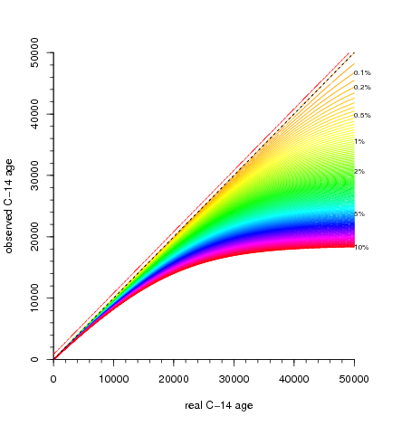
Contamination by Modern Carbon
-e.g. roots, in-lab contamination, fungus
After 40,000 years, only <1% radiocarbon remaining
Older materials are highly sensitive to contamination!
Image Source: Maarten Blaauw

Slide 16
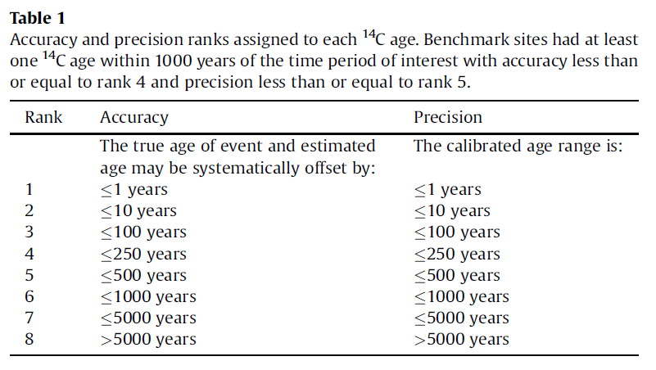
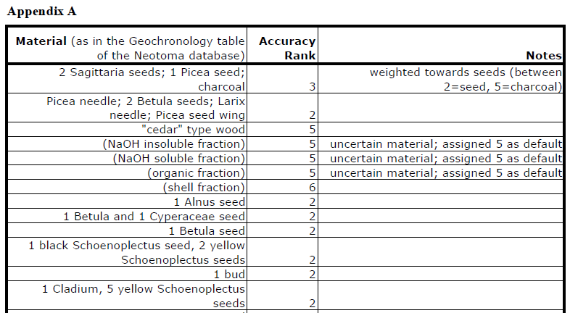
Assessing the quality of radiocarbon dates
Required for multisite syntheses!
Blois et al. 2011 QSR

Slide 17
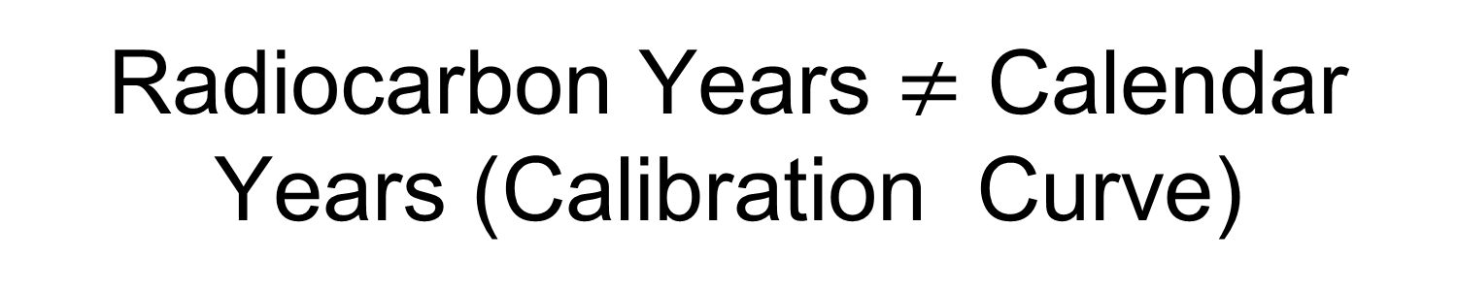
Radiocarbon Years $≠$ Calendar Years (Calibration Curve)
Lambda is a
constant (we think)
We measure N_{t} (¹⁴C
remaining) in our sample
N_{t}=N₀e^{-λt}
We want to
estimate time
N₀ is unknown!
Radiocarbon ages assume that N₀ is constant over time, i.e. the amount of ¹⁴C in the atmosphere is unchanged. This assumption is untrue.

Slide 18
Why ¹⁴C_{atm} is not constant
Both the production and removal of ¹⁴C to/from the atmosphere varies over time
Atmospheric production
Ocean/Vegetation/Atm C exchange
Hence, the amount of ¹⁴C in the atmosphere varies over time.
Hence N₀ varies, and is uncertain.
Ruddiman 14.15

Slide 19
We use Calibration Curves to estimate calendar age from ¹⁴C ages
Convert by dating many materials of known age.
Tree rings, varved sediments, corals, speleothems, …
Non-linear (wiggly)
Divergence increases with age

Slide 20
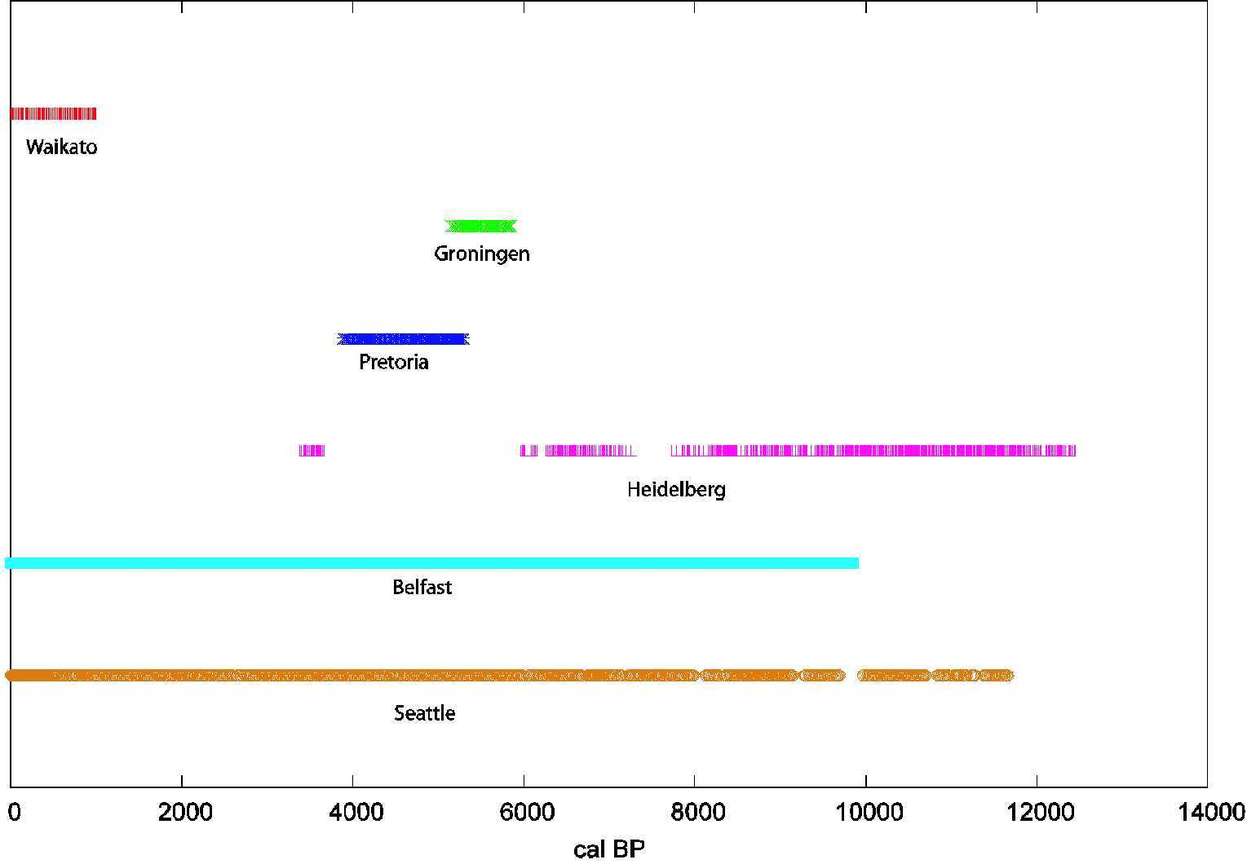
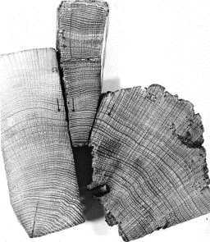
Tree rings are the most precise natural date available
9
Tree-rings are the basis for InCal09 until 12.55 kcal BP
Irish Oak
Waikato
German Oak
Groningen
German Oak
Pretoria
German Oak
German Pine
Swiss Pine
Heidelberg
Irish Oak
German Oak
Belfast
PNW/CA
German Oak
German Pine
Seattle
Image Source: Maarten Blaauw

Slide 21
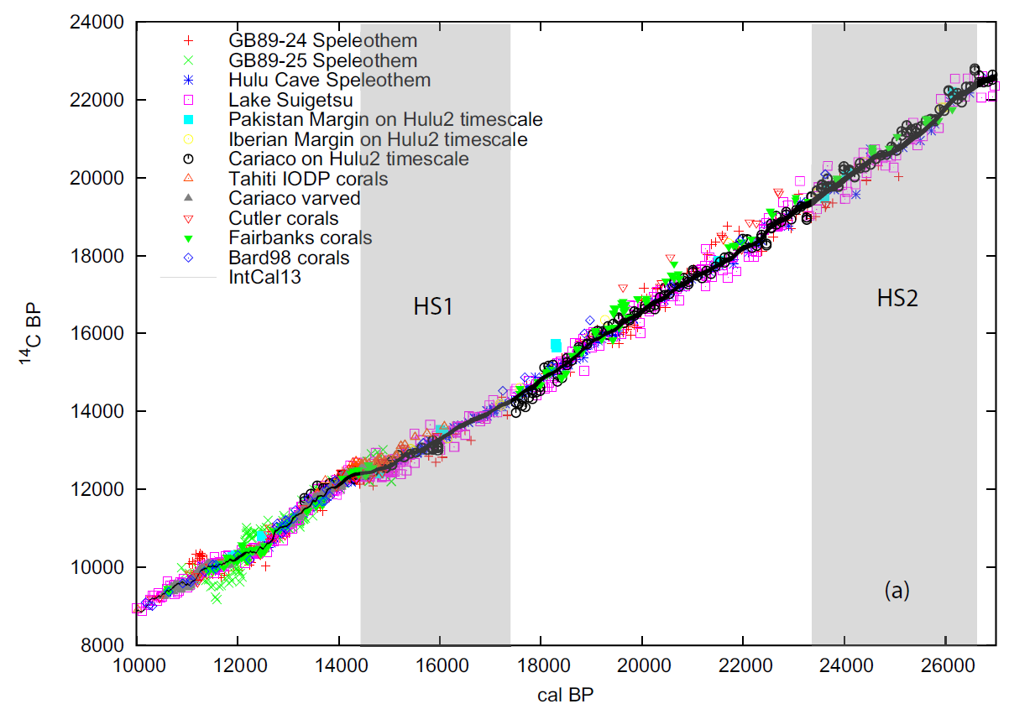
Speleothems, corals, varved sediments used for 12.5 to 50 ka
Reimer et al. 2013 Radiocarbon

Slide 22
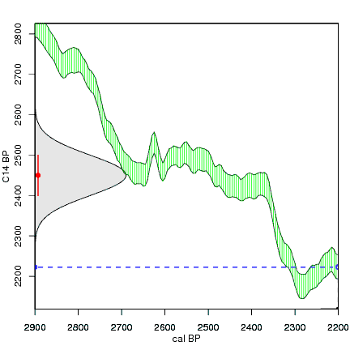
Wiggles in the Calibration Curve produce highly irregular age estimates
Original ¹⁴C
age estimate with a Student T distribution
… this has spurred development of age models that can handle these irregular uncertainty distributions
Resultant (highly irregular)
calendar age estimate
http:///www.chrono.qub.ac.uk/blaauw/

Slide 23
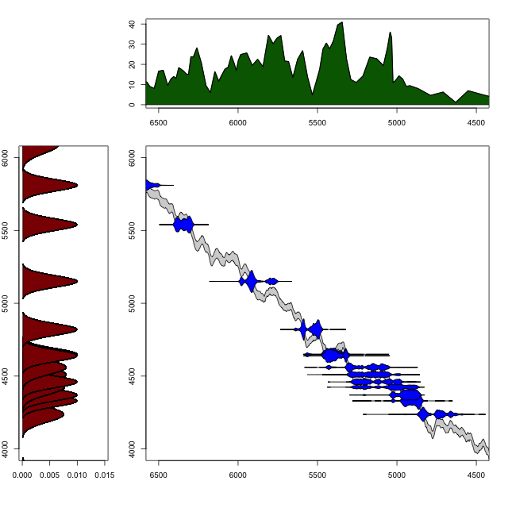
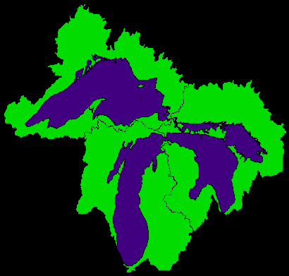
Using Wiggle-Matching to your Advantage:
Timing and Synchrony of the Tsuga Decline at Irwin Smith Bog
Tsuga pollen %
Best estimate:
5050 yr BP
¹⁴C dates
¹⁴C-years Before Present
Calendar-years Before Present
R.K. Booth, S. Brewer, M. Blaauw, T.A. Minckley & S.T. Jackson, 2012. Ecology.

Slide 24
Dating and age model uncertainty
Part I: Age Controls, Fundamentals of Radiocarbon Dating
Part II: Age-Depth Models & Chronologies, Classical Age Models
Part III: Bayesian Age-Depth Models & bacon

Slide 25
Age-depth models
Goal:
Age estimates for all depths in a core with uncertainty
Need to accommodate:
irregular uncertainty distributions for individual age controls
Variations in sedimentation rate, including hiatuses & rapid sedimentation events
Outlier dates and biased dates

Slide 26
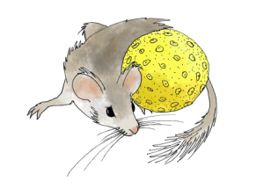
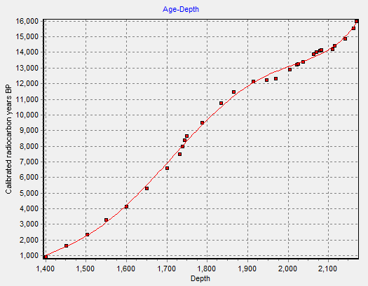
Chronologies and Age Models
An Age Model has two components:
Set of age controls
An algorithm for interpolating ages to analysis units between the ones with independent ages.
5th degree
polynomial

Slide 27
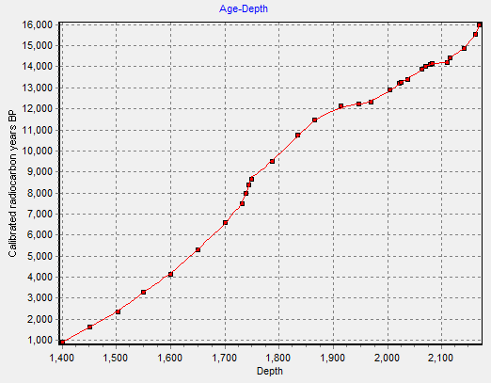
Chronologies and Age Models
An Age Model has two components:
Set of age controls
An algorithm for interpolating ages to analysis units between the ones with independent ages.
Cubic B-spline

Slide 28
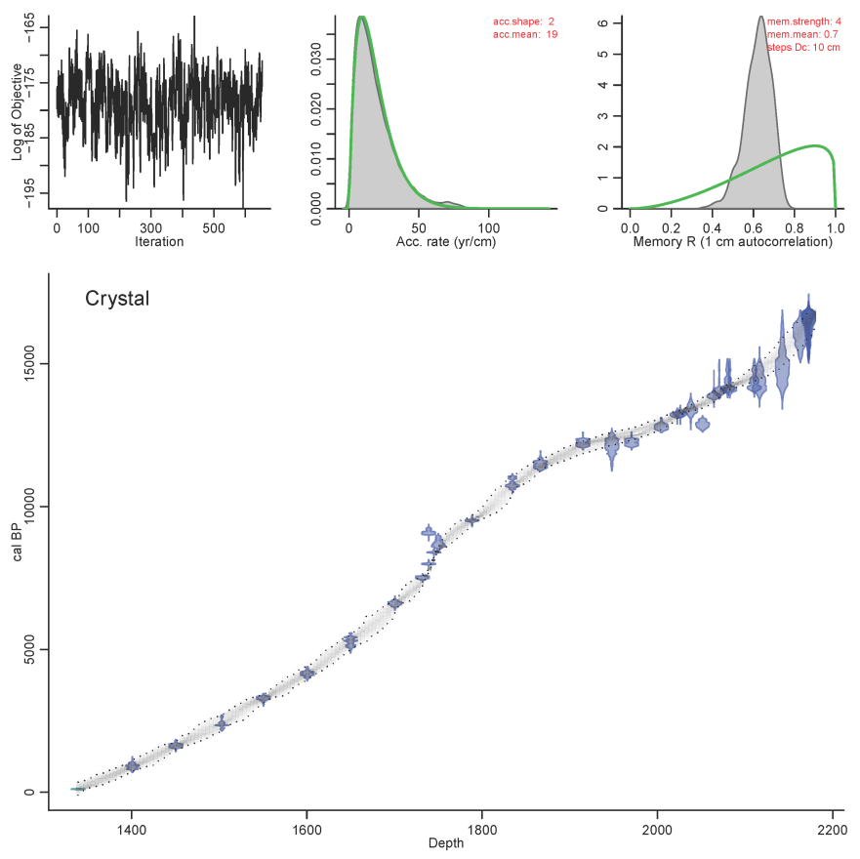
Chronologies and Age Models
An Age Model has two components:
Set of age controls
An algorithm for interpolating ages to analysis units between the ones with independent ages.
Bacon

Slide 29
Chronologies and Age Models
An Age Model has two components:
Set of age controls
An algorithm for interpolating ages to analysis units between the ones with independent ages.
A Chronology is a set of ages assigned to analysis units.
A chronology is based on an age model.

Slide 30
Geochronology
Geochronology
GeochronTypes
GeochronD
SampleID
GeochronTypeID
AgeTypeID
Age
ErrorOlder
ErrorYounger
Infinite
Delta13C
LabNumber
MaterialDated
Notes
GeochronTypeID
GeochronType
Amino acid racemization
Carbon-14
Cosmogenic
Electron spin resonance
Fission track
Potassium-argon
Optically stimulated luminescence
Lead-210
Silicon-32
Thermoluminescence
Uranium series
Carbon-14: accelerator mass spectrometry
Carbon-14: proportional gas counting
Carbon-14: liquid scintillation
Carbon-14: conventional radiometric
Argon-argon
Protactinium-231
Archaeomagnetic
Obsidian hydration
Paleomagnetic
Dendrochronological
In Neotoma, Geochronology stores the radiometric age controls

Slide 31
Chronologies
CollectionUnits
Chronologies
ChronControls
CollectionUnitID
SiteID
CollTypeID
DepEnvtID
Handle
CollUnitName
CollDate
CollDevice
GPSLatitude
GPSLongitude
GPSError
WaterDepth
Location
Notes
ChronologyID
CollectionUnitID
AgeTypeID
ContactID
IsDefault
ChronologyName
DatePrepared
AgeModel
AgeBoundYounger
AgeBoundOlder
Notes
ChronControlID
ChronologyID
ChronControlTypeID
Depth
Thickness
Age
AgeLimitYounger
AgeLimitOlder
Notes
In Neotoma, ChronControls stores the age controls used in an age model. Chronologies stores the age model metadata

Slide 32
‘Classical’ Age Models: Three common varieties
Linear Interpolation (connect the dots)
Regression
Linear Regression
Polynomial Regression
Smooth Spline

Slide 33
Classical Age Models & Uncertainty
Classical age models do not treat uncertainty very well.
Most treat age controls as point estimates & do not handle irregular probability distributions
Fitted models do not accommodate local uncertainties due to few dates, conflicting dates, etc.
Few paleo-papers formally incorporate age uncertainty into analyses.

Slide 34

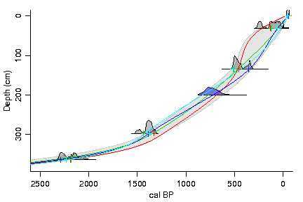
CLAM: Good option for classical age models
R software
available from Blaauw’s website
R package at https://github.com/SimonGoring/clam
Internally calibrates ¹⁴C dates, using latest IntCal
User selects model type (linear interpolation, spline, regression)
Repeatedly samples from calibrated ¹⁴C to fit multiple curves, better estimates of uncertainty
Images: Maarten Blaauw

Slide 35
Dating and age model uncertainty
Part I: Age Controls, Fundamentals of Radiocarbon Dating
Part II: Age-Depth Models & Chronologies, Classical Age Models
Part III: Bayesian Age-Depth Models & bacon

Slide 36
Bayesian Age Models
Combine new information (age controls) with prior information
Major Priors include:
Stratigraphic Superposition: Deeper sediments are older (Steno’s Law)
Sediment accumulation rate
Sediment ‘Memory’ (i.e. the autocorrelation or variability between depths)
Hiatuses
Output: Probabilistic estimates of age given priors and age controls

Slide 37
A quick list of Bayesian Age Models
MexCal: Christen, 1994. PhD thesis Nottingham
BCal: Buck et al., 1999. Internet Archaeology 7
Best for discrete horizons (e.g. top and bottom age estimates for a archeo-cultural horizon)
OxCal: Bronk Ramsey, 2008. QSR 27:42-60
Widely used
Bpeat: Blaauw & Christen, 2005. Appl Stat 54: 805-816
Superseded by bacon
Bacon: Blaauw & Christen, 2011. Bayesian Anal 6: 1-18
Widely used. What we’re using for PalEON.

Slide 38
Bacon
Divides a core into n cm-thick sections
Models accumulation for each section (with separate parameters for each section
MCMC
Priors for:
Accumulation rate
Sediment memory
Hiatus locations
Outlier age controls identified using Student T distribution
Can plot proxies as greyscales – ‘Ghost Plots’
Can calculate probability of synchrony of events between sites

Slide 39
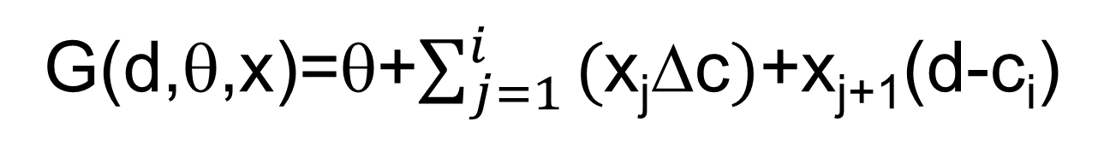
The Bacon Model (Part 1)
Depth to Calendar Age Model (G)
G(d,θ,x)=θ+$\sum_{j=1}^{i}{\text{(}\text{x}\text{j}\text{D}\text{c})}$+x_{j+1}(d-c_{i})
where:
d=depth of radiocarbon sample
c_{i}=uniformly separated depth intervals
Δc=depth interval
x_{j}=sediment accumulation rate for section j
θ=intercept
Sediment rates (x) modeled as a Gamma autoregressive model
Radiocarbon ages (y) modeled as Student T distributions

Slide 40
The Bacon Model (Part 2)
Radiocarbon to Calendar Age Model (μ)
E[y_{j}|d_{j},x]=μ(G(d_{j},θ,x))
where:
y=radiocarbon ages
d=depth of radiocarbon sample
x_{j}=sediment accumulation rate for section j
θ=intercept
Sediment rates (x) modeled as a Gamma autoregressive model
Radiocarbon ages (y) modeled as Student T distributions

Slide 41
Bacon example – Spicer Lake, IN
MCMC Chain
Green=Prior
Gray=Posterior
Notice higher uncertainty when no data
15 AMS dates + core top
Some charcoal dates with very small sample sizes apparently too young
Wang et al. in prep.

Slide 42
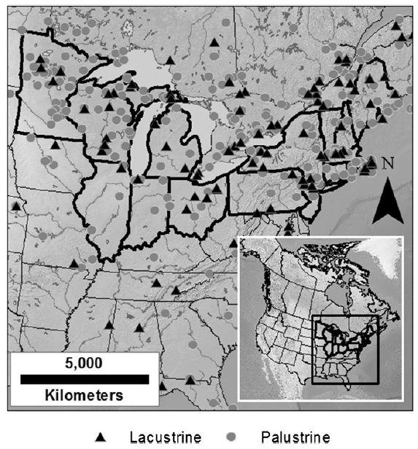
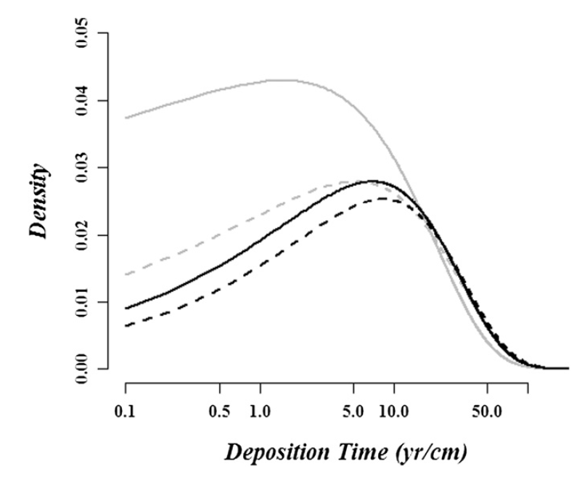
Setting Priors in Bacon
Sediment Accumulation Rate: Use Goring et al 2012!
Sediment memory - Bacon uses a fairly non-informative prior
Hiatuses: use your judgment
Also: Number of Sections.
Not a prior – determines # of . More sections allow more flexibility in age-depth curve, but too many will cause bacon to hang
Gamma Distributions
Goring et al. 2012

Slide 43
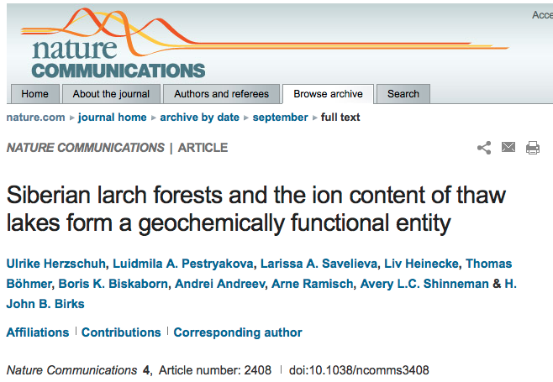
Good models do not substitute for good judgment
“We used the BACON software³⁸ on twelve ¹⁴C dates to construct a robust age-depth model (for details, see Supplementary Note 1). The reliability of the inferred ages from the lower part is supported by an almost similar age-depth model generated from the extrapolation of the mean sedimentation rate inferred from ²¹⁰Pb dating of the upper part of the core.”
Example from Blaauw

Slide 44
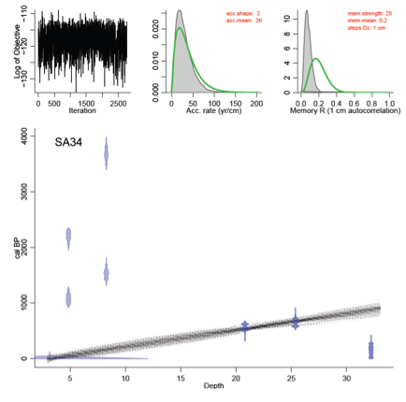
Example from Blaauw

Slide 45
EXTRA SLIDES

Slide 46
Terminology
Age Control: an estimate of absolute age, often with a specified uncertainty, for a sample within a core or stratigraphic profile that is used to constrain an age model.
Age-Depth Model – an algorithm used to estimate the age-depth relationship for a series of stratified paleoenvironmental data points. Age-depth models are used to make estimates of ages for depths not directly associated with an age control or to resolve discrepancies among age controls.
Chronology – a series of estimated ages and associated uncertainty estimates for samples in a stratigraphic sequence. Such estimates usually derive from an age-depth model and its associated age controls.
Source: Grimm et al. 2014 Age Models, Chronologies, and Databases Workshop: Complete Report and Recommendations. PAGES Workshop Report. Queens University, Belfast.

Slide 47
Central Message of Today’s Lecture
An understanding of dating methods is essential to informed interpretation of paleoclimatic data.
These two lectures will introduce you to some of the most commonly used techniques.

Slide 48
N
P
P
N
P
P
N
P
P
N
N
N
N
N
N
N
N
N
N
P
N
P
P
P
P
P
P
P
P
P
P
P
N
N
N
N
N
N
N
¹²C
¹³C
¹⁴C*
6 protons
6 neutrons
6 protons
7 neutrons
6 protons
8 neutrons

Slide 49
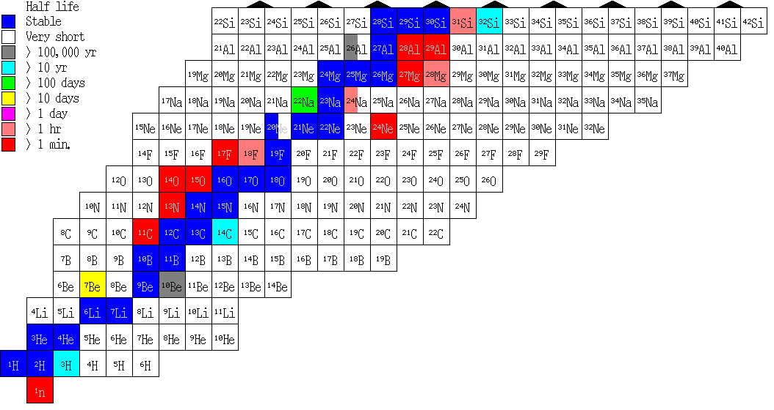
(Partial) Chart of All Known Nuclides
http://atom.kaeri.re.kr/ton/

Slide 50
Radiometric Dating
N=N₀e^{-λt}
t_{1/2} = (ln 2)/λ
5,730 years
Ruddiman 2.9, Table 2.1

Slide 51
Calibration Curves: ¹⁴C Age vs. Calendar Age
Non-linear (wiggly)
Divergence increases with age
Based on empirical data – ¹⁴C dates of objects of known age

Slide 52
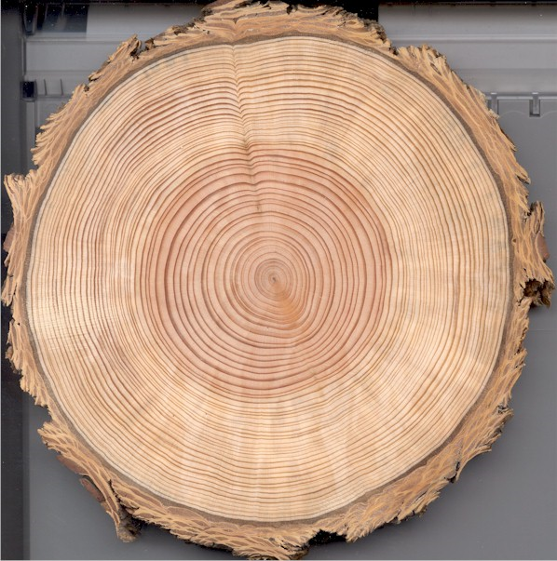
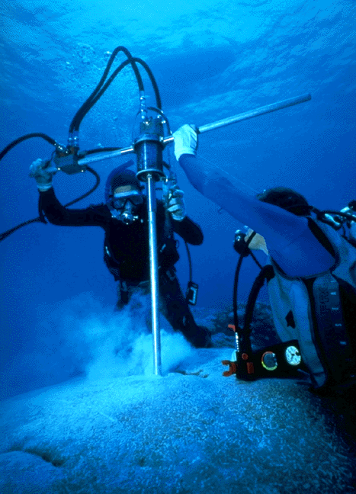
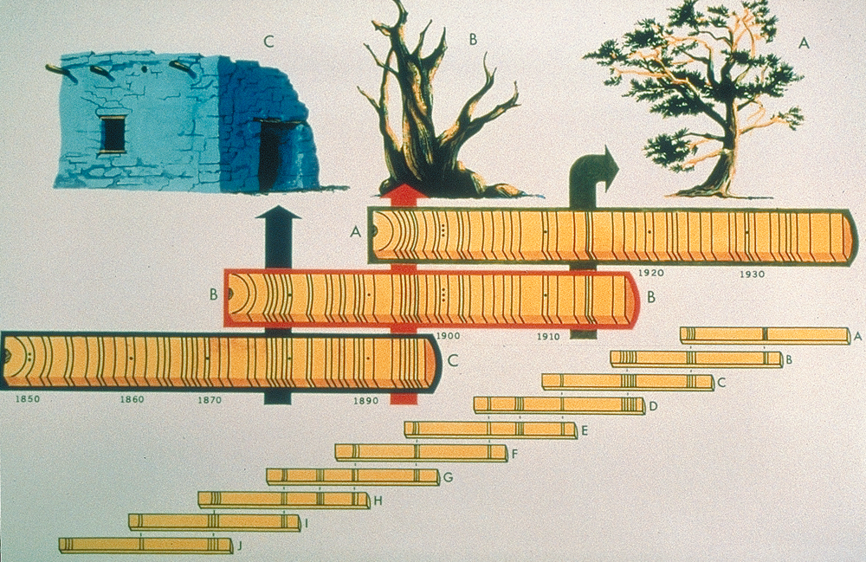
Tree-rings and Corals are the most common calibrators of ¹⁴C curves
Laboratory of Tree-Ring Research,
The University of Arizona
NOAA Paleoclimatology/Department of Commerce
www.ncdc.noaa.gov

Slide 53
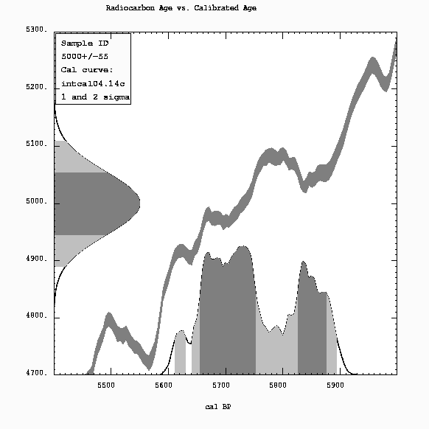
Converting from ¹⁴C to Calendar Years
¹⁴C: 5000 +/- 55
Cal: 5656 – 5753
5826 – 5877
Calib 5.0.2

Slide 54
Uranium Series Decay Chains
NUCLIDE HALF-LIFE
Uranium-238 ²³⁸U 4.51x10⁹ yr
Uranium-234 ²³⁴U 2.5x10⁵ yr
Thorium-230 ²³⁰Th 7.52x10⁴ yr
Radium-226 ²²⁶Ra 1.62x10³ yr
Radon-222 ²²²Rn 3.83 days
Lead-210 ²¹⁰Pb 22 yr
Polonium-210 ²¹⁰Po 138 days
Lead-206 ²⁰⁶Pb stable
NUCLIDE HALF-LIFE
Uranium-235 ²³⁵U 7.13x10⁸ yr
Protactinium-231 ²³¹Pa 3.24x10⁴ yr
Thorium-227 ²²⁷Th 18.6 days
Radium-223 ²²³Ra 11.1 days
Lead-207 ²⁰⁷Pb stable
From Bradley 1999

Slide 55
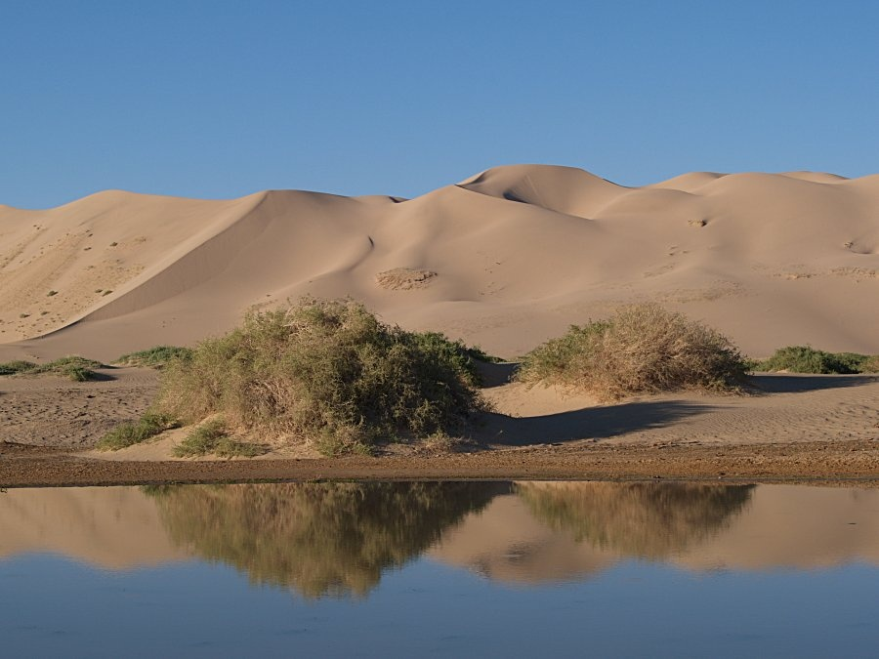
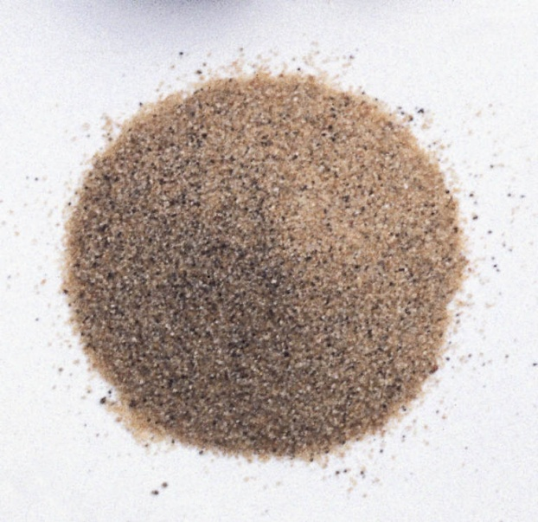
Luminescence Dating

Slide 56
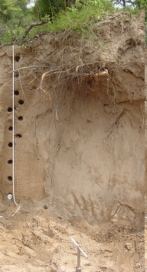
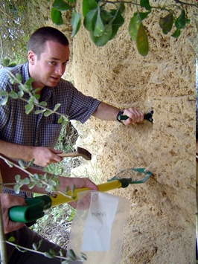
Field Collection of OSL Samples
http://www.shef.ac.uk/scidr/luminescence

Slide 57
Paleomagnetism

Slide 58
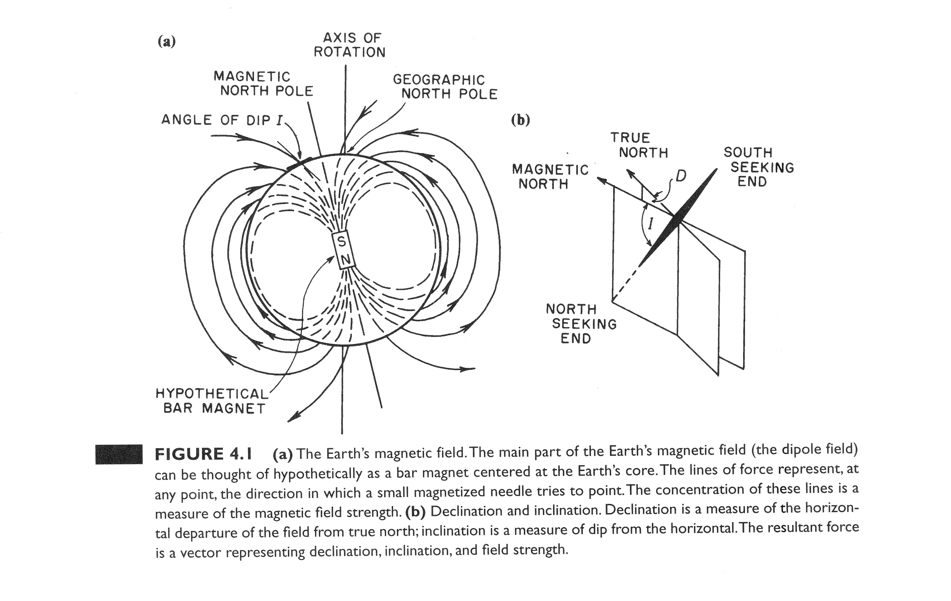
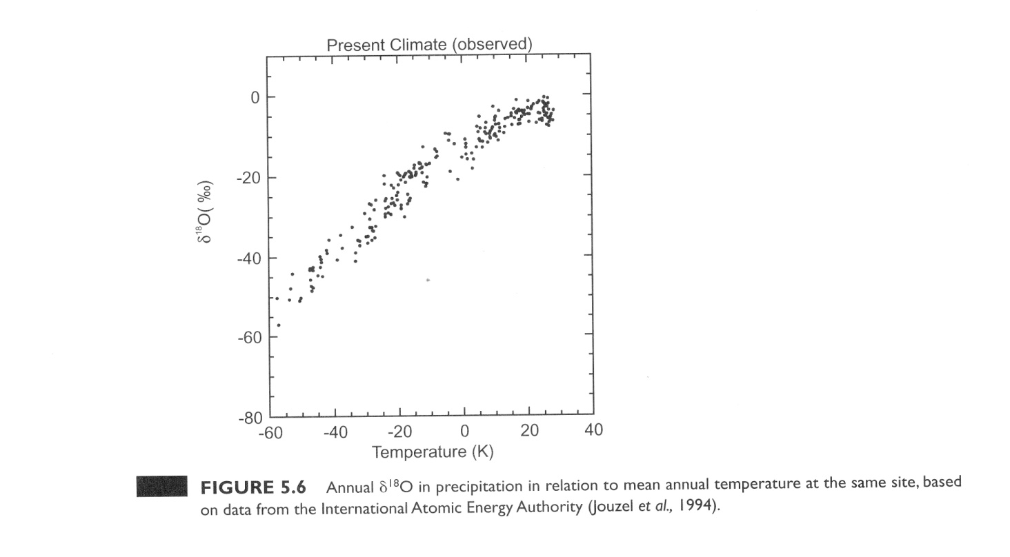
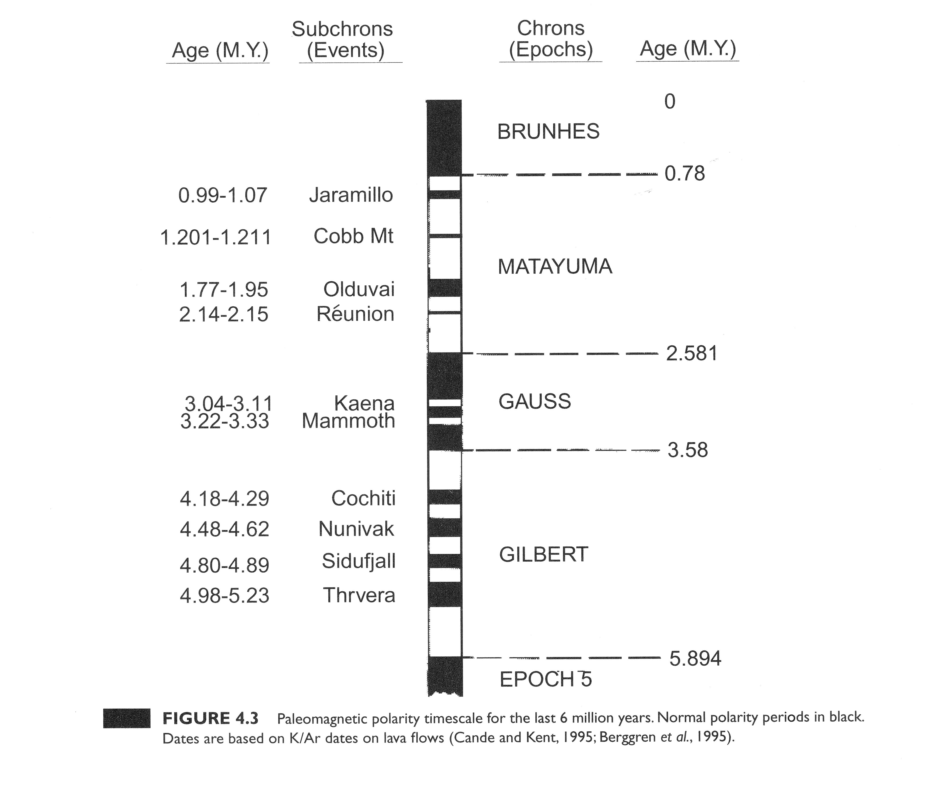
Bradley, Paleoclimatology

Slide 59
Age-Depth Plot
younger
Age
older
top
Hiatus
Depth
bottom

Slide 60
Age Model I: constant sedimentation rate
younger
Age
older
top
Hiatus
Depth
bottom

Slide 61
Age Model II: linear sed. rate between dates
younger
Age
older
top
Hiatus
Depth
bottom

Slide 63
SCRAP

Slide 64
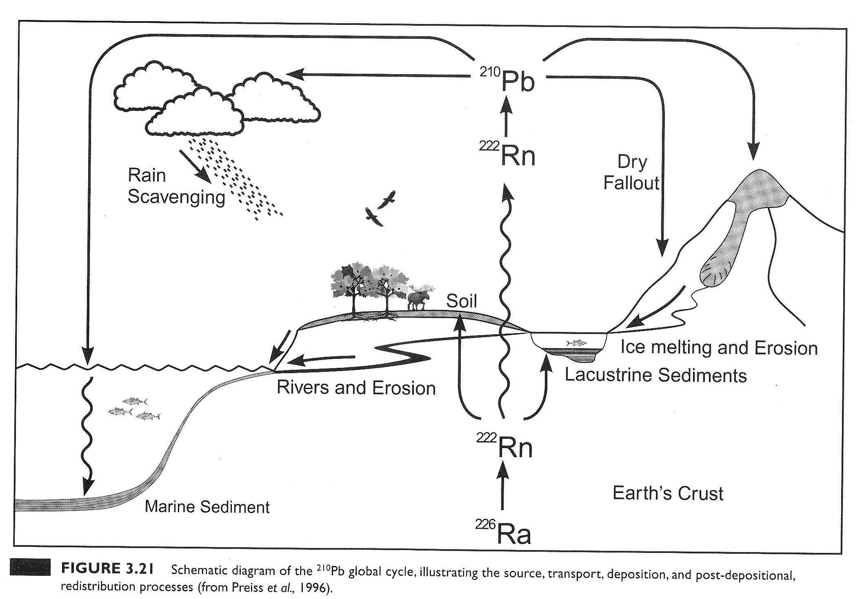
²¹⁰Pb Global Cycle
Bradley Paleoclimatology Fig. 3.21

Slide 65
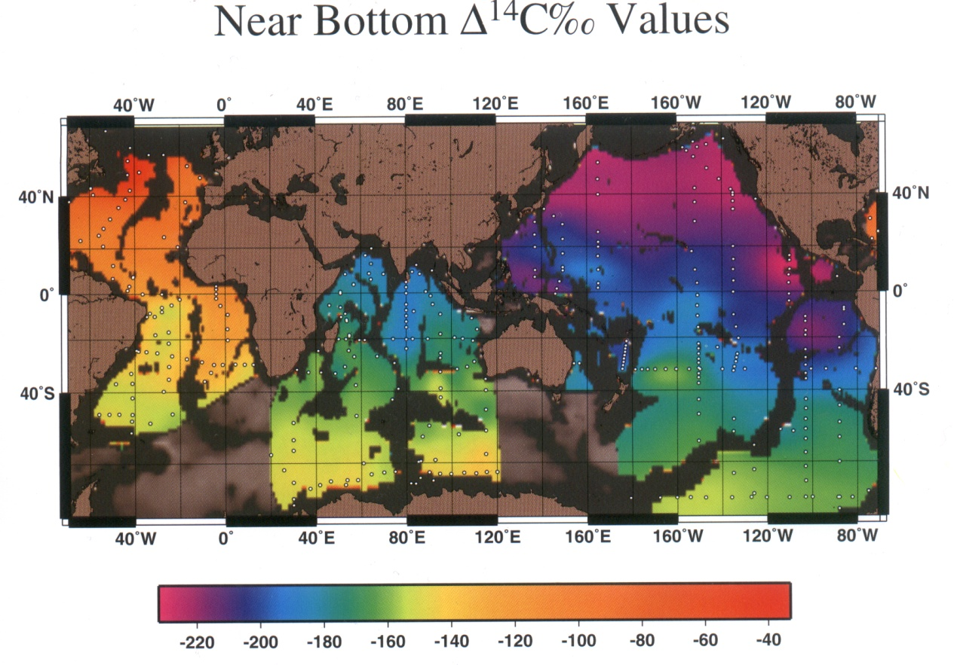

Deep Ocean Circulation

Slide 67


AMS Schematic
Source: NSF-Arizona AMS Lab
http://www.physics.arizona.edu/ams/facility/newams.htm

Slide 68
What is the one difference between ecologists and paleoecologists?
For paleoecologists, time is an unknown variable. It must be estimated.

Slide 69

Some nuclides are stable – others are unstable (radioactive)
Principles of Radiometric Dating
(e.g. ¹⁴C, ²¹⁰Pb)
N
P
P
N
P
P
N
P
P
N
N
N
N
N
N
N
N
N
N
P
N
P
P
P
P
P
P
P
P
P
P
P
N
N
N
N
N
N
N
¹²C
¹³C
¹⁴C*
6 protons
6 neutrons
STABLE
6 protons
7 neutrons
STABLE
6 protons
8 neutrons
UNSTABLE

Slide 70


Slide 71

Which age-depth model?
800 cm core
9 ¹⁴C dates
surface = recent
Example: Maarten Blaauw

Slide 72

Which age-depth model?
800 cm core
9 ¹⁴C dates
surface = recent
Linear interpolation
Too much weight on
individual dates?
Uncertainty?
Example: Maarten Blaauw
Example: Maarten Blaauw

Slide 73

Which age-depth model?
800 cm core
9 ¹⁴C dates
surface = recent
Linear interpol.
date 6 = outlier
Example: Maarten Blaauw
Example: Maarten Blaauw

Slide 74

Which age-depth model?
800 cm core
9 ¹⁴C dates
surface = recent
Linear interpol.
470 cm = hiatus
Example: Maarten Blaauw
Example: Maarten Blaauw

Slide 75

Which age-depth model?
800 cm core
9 ¹⁴C dates
surface = recent
Linear interpol.
Linear regression
470 cm = hiatus
Too narrow error ranges?
Especially for undated intervals
Example: Maarten Blaauw

Slide 76

Which age-depth model?
800 cm core
9 ¹⁴C dates
surface = recent
Linear interpol.
Linear regression
Polynomial regression
470 cm = hiatus
second degree
Unreliable extrapolation
No physical basis for parameters

Slide 77

Which age-depth model?
800 cm core
9 ¹⁴C dates
surface = recent
Linear interpol.
Linear regression
Polyn. regression
Smooth spline
Uncertainty? Also note reversal
of age-depth relationship
Example: Maarten Blaauw

Slide 78

Wiggles in the Calibration Curve
Radiocarbon Year BP
Calendar Year BP

